Slide 1
Week 3 Update
AA 290 / AA 279D
10/8/2019

Slide 2
Contents
Simulink Setup
Curvilinear
J2 Effects
Drag Effects

Slide 3
Simulink Setup Updates
Added in ability to toggle between:
Gravity types
Drag on/off
Dynamic Types (non-linear equations / Keplerian Propagation)
Added in curvilinear frame for relative outputs
Added in more processing of outputs in the sim to decrease post-processing needs after

Slide 4
Curvilinear Frame
Wanted to represent the relative position of the satellites in curvilinear frame
Not perfectly accurate as of right now, but gives good visualization
Starting at 200 km R-bar and 100 km V-bar with 0 eccentricity we see that the orbit moves behind the chief and has fluctuations in radius (conversion to curvilinear isn’t perfect as the deputy moves further away from the chief)

Slide 5
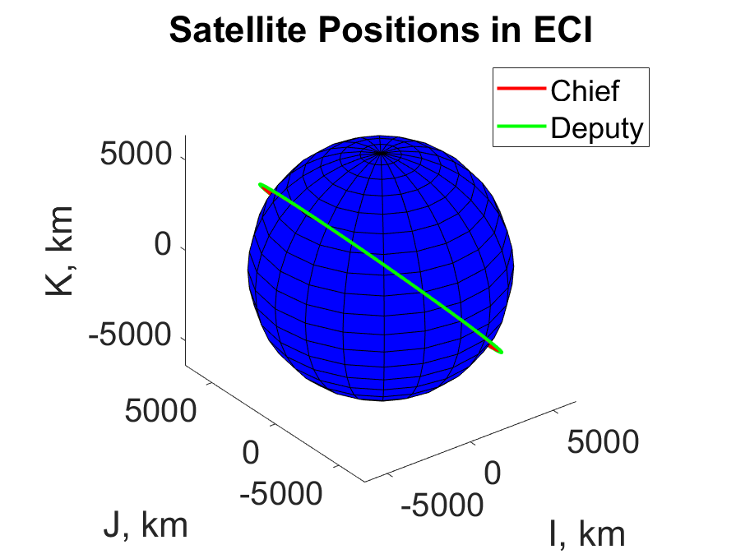
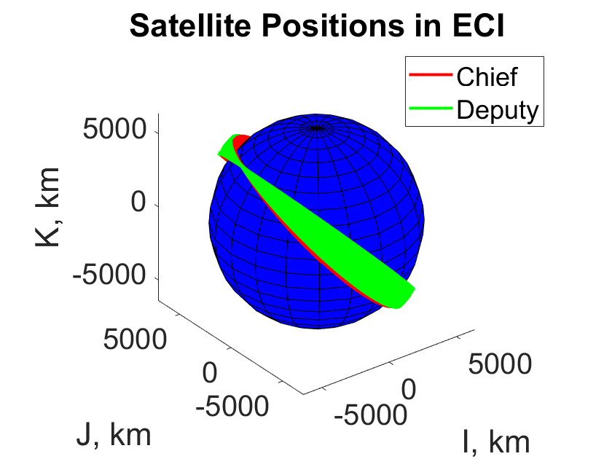
J2
Added in the J2 effect
Causes change in right ascension of the ascending node and argument of perigee as expected

Slide 6
~Constant
~Constant
~Constant
Oscillations due to near circular shape

Slide 7
Drag
Computed drag in the ECI frame
Used mass and area of the satellites to compute the inverse ballistic coefficient
Deputy satellite is affected more by drag (larger area) which can be seen in relative position
Drag affects semi-major axis and eccentricity as seen on next slide

Slide 8
~Constant
~Constant
~Constant

Slide 9
Questions
Ways to improve accuracy of curvilinear frame?
In PS2, it wants to create bounded, periodic relative motion by using a maneuver. What exactly is meant by this?

